Slide 1


Using Formulation and Processing in Food-Based Dietary Guidelines
Barbara Schneeman Ph.D.
Professor Emerita, UC Davis

Slide 2
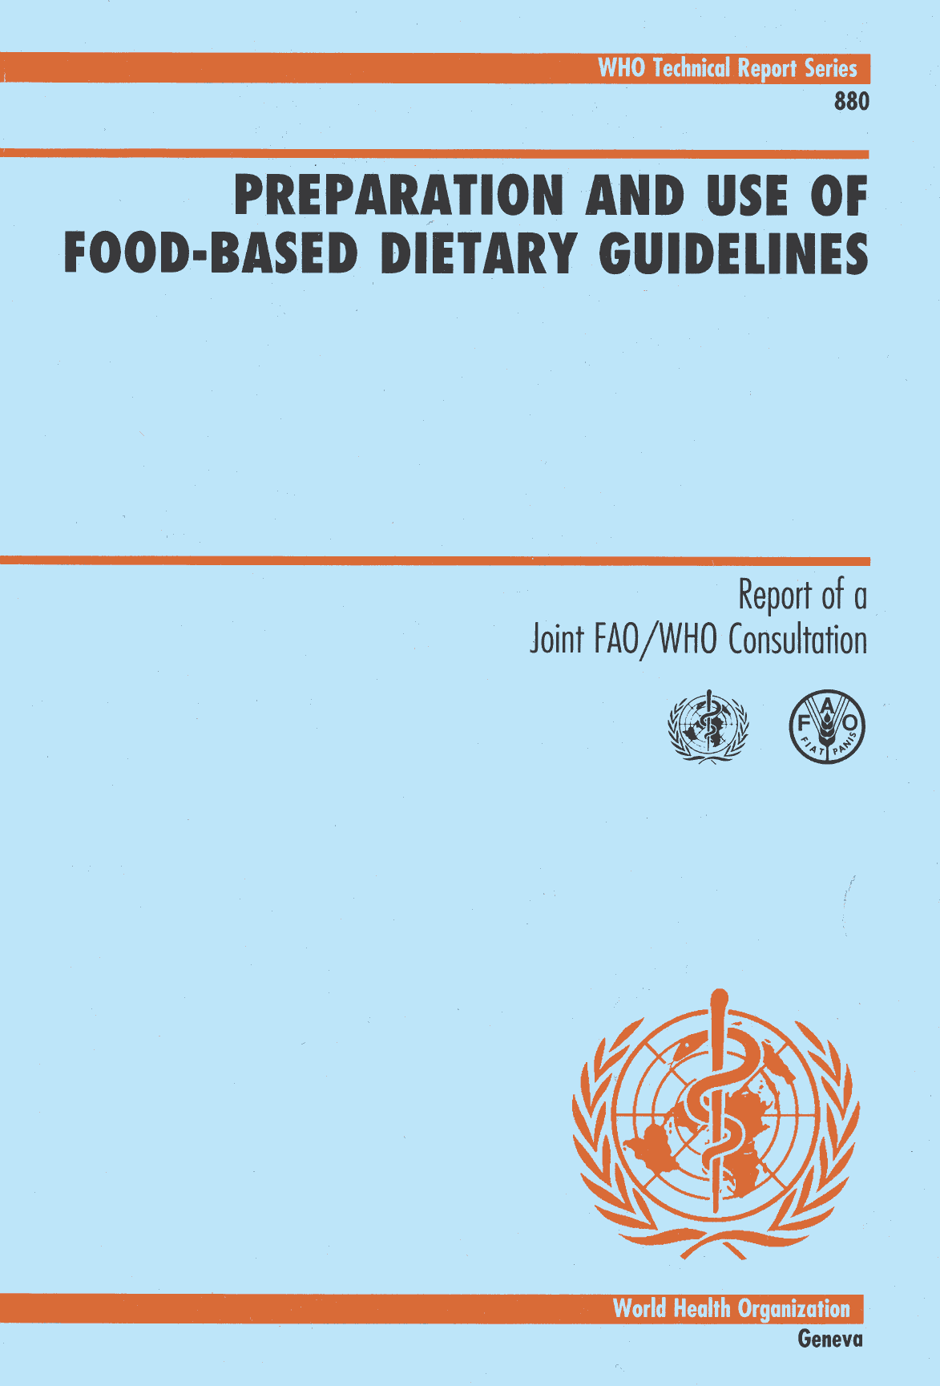
Importance of Food-Based Dietary Guidelines (FBDG)
Focus on relevant public health issues related to diet
Recognize social, economic, agricultural, and environmental aspects of foods and eating patterns
Reflect food patterns rather than numeric goals
Positive and encourage enjoyment of appropriate dietary intakes.
Identifying various dietary patterns can be consistent with good health.
Utilize a systematic process to develop science-based FBDG
Creates a common framework for policy development

Slide 3
Importance of Food-Based Dietary Guidelines (FBDG)
Focus on relevant public health issues related to diet
Recognize social, economic, agricultural, and environmental aspects of foods and eating patterns
Reflect food patterns rather than numeric goals
Positive and encourage enjoyment of appropriate dietary intakes.
Identifying various dietary patterns can be consistent with good health.
Utilize a systematic process to develop science-based FBDG
Creates a common framework for policy development

Slide 4
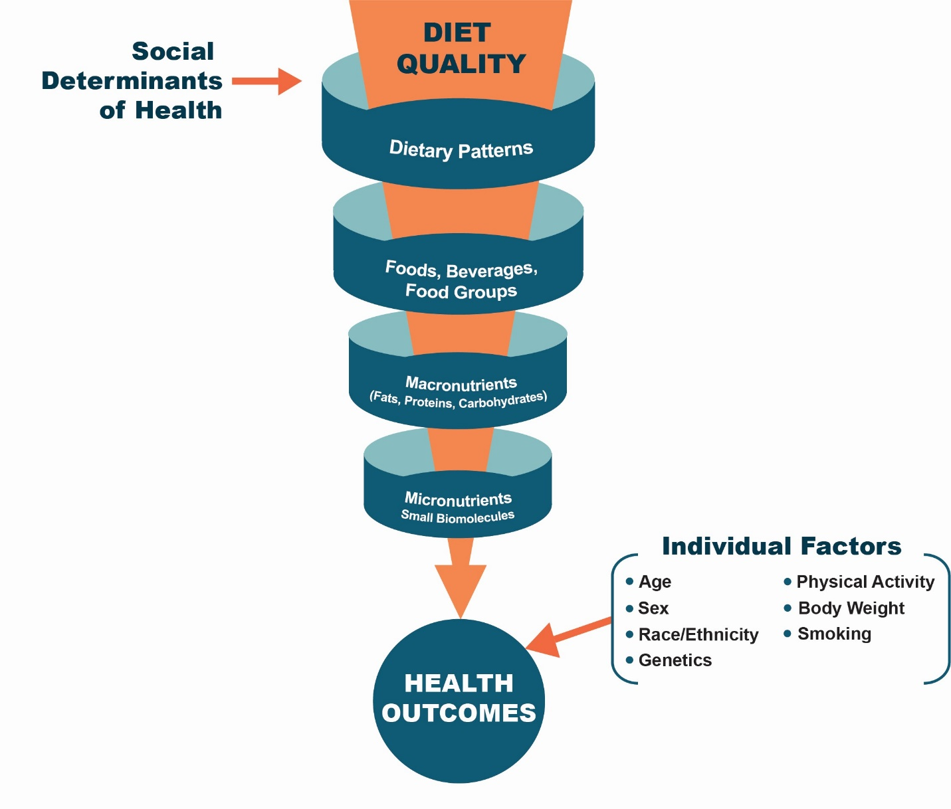
Relevance of Dietary Patterns in Food-Based Dietary Guidelines
Based on the report from the 2020 Dietary Guidelines Advisory Committee.

Slide 5
How can formulation and processing be used in food-based dietary guidelines (FBDG)?
What is the nature of the evidence used to develop FBDG?

Slide 6

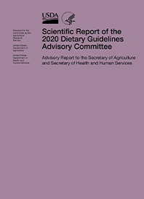
What is the nature of the evidence used to develop FBDG?
Example of process used to update the Dietary Guidelines for Americans every 5 years.
Scientific report from the Dietary Guidelines Advisory Committee is developed in response to questions from the federal government.
What methods are used to evaluate evidence?

Slide 7



Dietary Guidelines for Americans: Approaches to Examine the Evidence
Systematic Reviews
Protocol-driven methods to search for, evaluate, synthesize, and grade the strength of the eligible body of evidence focused on relationships between diet and health outcomes.
Data Analysis
Analyses of national data sets to describe the current health and dietary intakes of the population across life stages.
Food Pattern Modeling
Food pattern modeling is a way to evaluate how dietary adjustments can meet nutritional goals. These food pattern modeling analyses inform the development of healthful dietary patterns for the population.

Slide 8
Review of Ultra Processed Foods by the 2025 DGAC
Question to the DGAC: What is the relationship between consumption of dietary patterns with varying amounts of ultra-processed foods and growth, body composition, and risk of obesity?
DGAC refers to the Dietary Guidelines Advisory Committee;
Report is at https://doi.org/10.52570/DGAC2025
.

Slide 9
Review of Ultra Processed Foods by the 2025 DGAC
Question to the DGAC: What is the relationship between consumption of dietary patterns with varying amounts of ultra-processed foods and growth, body composition, and risk of obesity?
For Infants and young children, individuals during pregnancy and postpartum: Grade not assignable
Concerns with consistency and directness of the evidence or not enough evidence.
For Children and Adolescents, Adults and Older Adults : Grade is Limited
Inconsistency among definitions, need for more rigorous definition
Recommend future consideration if more rigorous definition is developed; consider other health outcomes.
DGAC refers to the Dietary Guidelines Advisory Committee;
Report is at https://doi.org/10.52570/DGAC2025
.

Slide 10
WHO Guidelines for Development of Recommendations
Use of the GRADE process for systematic reviews
Evaluation of strength of evidence
Criteria to consider in moving from evidence to recommendations

Slide 11
Evidence needed for development of FBDG
-Food classification systems need to consider the types of evidence required for development of food-based dietary guidelines.
-Such evidence has traditionally focused on formulation and emerging evidence suggests the need to consider processing.

Slide 12
Formulation and processing are distinct
Formulation: “Systematic selection of relative quantities of ingredients for a food product”
Processing: “Treatment of a food material to achieve a desired effect”
Definitions from the IUFoST report

Slide 13
IUFoST approach to evaluate formulation and processing
Formulation: “Systematic selection of relative quantities of ingredients for a food product”
Evaluation of formulation is determined by the nutrient profile of ingredients in the food product For nutritive value, the Task force used the Nutrient Rich Food Index (NRF) based on 9 recommended nutrients and 3 nutrients to limit. *
Processing: “Treatment of a food material to achieve a desired effect”
Evaluation of processing is determined by the change in the nutritive value due to the processing treatment
The Task Force examined formulation and processing in relation to nutritive value. However, the approach can be adapted to other parameters
*Recommended nutrients: protein, dietary fiber, vitamin A, vitamin C, calcium, iron, potassium & magnesium
Nutrients to Limit: added sugars, saturated fatty acids, sodium (Drewnowski 2010)

Slide 14
Formulation and processing can have positive or negative effects on nutritive value of food
Processing is based on treatment, eg The ΔNRF Score
Formulation is based on ingredients, eg The NRF Score
Processing of food products can improve, have no effect, or reduce the nutritional properties of the product.
Certain types of processing are essential to convert raw products into safe, edible foods.
Processing of foods can occur at the household level, in food service establishments, and within industries preparing packaged foods.
Formulation of food products can result in products that help achieve healthful dietary patterns or that should be limited in a healthful dietary pattern (e.g. sources of sodium, saturated fats, added sugars).

Slide 15
Defining Points of Classification (POC)
Point of Purchase (POP)
From IUFoST report 2025

Slide 16
Approach to Classification
IUFoST Classification
Classifications that only consider properties at Point of Purchase
Definable food components, e.g. Nutrient Rich Food Index (NRF)
Measured at point of purchase and prior to processing
Characterizes nutrient value related to formulation and change in nutrient value due to processing
Can be adapted to other properties of food
Specific components related to food ingredients and processing are not well-characterized.
Generalized association with risk of chronic disease, often explained by formulation
Changes due to processing not measured directly.

Slide 17
How can formulation and processing be used in food-based dietary guidelines (FBDG)?
Most FBDGs incorporate recommendations for healthful dietary patterns that are based on formulation of food products.
Characterizes the contribution of ingredients to nutrient value of foods
Determines if foods are nutrient dense or energy dense.
Evidence based on formulation is used in policy decisions, such as food labelling
The impact of processing technology on healthful dietary patterns is an emerging area of research.
This research requires collaboration across disciplines to assure that current processing technology is understood and not mis-characterized as formulation.
Research on the effects of processing are needed to incorporate recommendations in food-based dietary guidelines and to improve processing technology.

