Slide 1






Beyond Ultra-Processed Foods:
A Comprehensive Multi-Criteria
Classification Approach for Food Products
Erich Windhab¹ IUFoST Task Force on Processing for Nutrition, Diet & Health
¹ Swiss Federal Institute of Technology Zürich (ETH); Institute of Food, Nutrition and Health
ICN-IUNS World Congress
August 27, 2025
Redefining Food Processing: Critical Interventions Enabling Food Security, Supporting Consumer Needs and Sustainability of Global Food Systems

Slide 2


1. Multi - Faceted Food Quality Assessment FRAMEWORK (PRISM)
Erich J.
Windhab
Task Force
1. Real Live Scenario - experience of food product developers & chefs
PRISM
Framework
with
six
property
facets
Sustainability
Facet
Safety / shelf life
Facet
(EARTH)
(SHIELD)
Product
Rating
Integration
System for
Multi-characteristics
3
4
5
6
Nutrition value
Facet
Affordability
Facet
PRISM
P⁺
(VALUE)
N utritional
O ptimization
U nder
R efined
I ngredient
S election &
H andling
Scheme
F⁻
(NOURISH)
ΔNRF*x.y.z
(NOURISH)
Processeing (P)
F⁺
P⁻
NRF*x.y.z
Formulation (F)
Palatablility
Facet
Convenience
Facet
The NOURISH scheme is a tool applicable
for refining the NOVA classification system
to avoid its ambiguities and lack of science
Definition, Differentiation and
Quantification of F&P impacts
on the product Nutrition Value
(TASTE)
(EASE)

Slide 3
2. Nutrition Value related product classification SCHEME (NOURISH = IF&PC)
Erich J.
Windhab
Task Force
1. Real Live Scenario - experience of food product developers & chefs
Ahrné, L., Chen, H., Henry, C.J.,Kim H-S.,Schneeman B. & Windhab E.J. (2025). npj Science of Food 9, 56 (2025). https://doi.org/10.1038/s41538-025-00395-x
Related
Parameters ΔX
Related
Parameter X
Food Quality
Determinant
(= PRISM facet)
measured
AFTER
processing
Measured
BEFORE
processing
ΔNRF (nutrition Rich
Food Index)
NRF₂ – NRF₁
NRF
Nutrition Rich Food Index
impact of PROCESSING
Impact of FORMULATION
1. Nutrition Value
NRF₂
PROCESS
(System)
NRF₁
NRFx.y = NRx - LIMy
x Nutrients Recommended
y Nutrients to LIMit
ΔNRF
EXTENSIONS
*
FORMULATION: NRF x.y _{100 kcal} = NRx_{100kcal} - LIMy_{100kcal}
.z
- ANz_{100kcal} ± AIF_{100kcal} ± …
*
PROCESSING: ΔNRF x.y _{100 kcal} = ΔNRx_{100kcal} - ΔLIMy_{100kcal}
.z
- ΔANz_{100kcal} ± ΔAIF_{100kcal} ± …
(anti-nutrient)
(additive impact)
Notes:
But how to quantify processing impact on the NV (expressed by NRF?? … > balance equations > NRF (for F) and Delta NRF (for P)

Slide 4
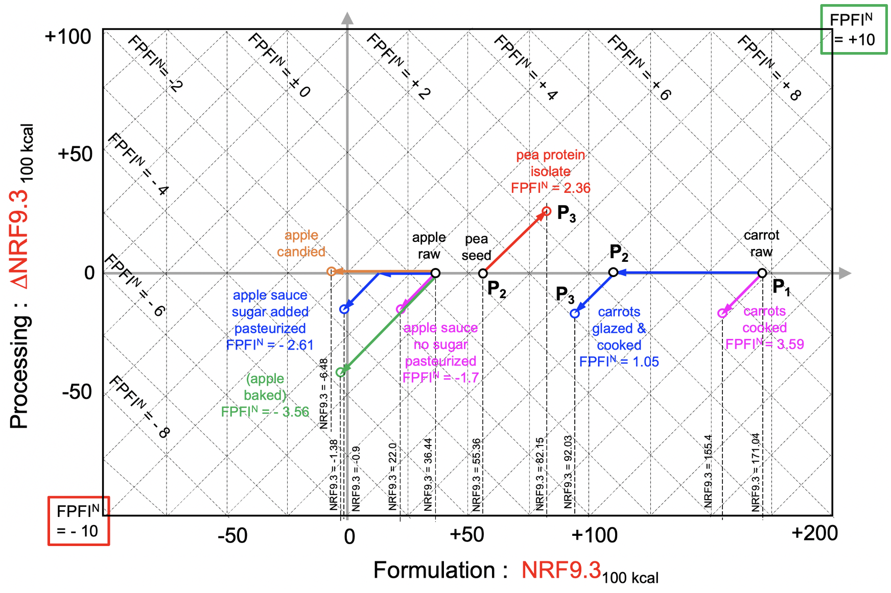
2. Nutrition Value related product classification SCHEME (NOURISH)
Erich J.
Windhab
Task Force
1. Real Live Scenario - experience of food product developers & chefs
Erich J.
Windhab
IUFoST
Formulation
and Processing
Classification
(NOURISH = IF&PC)
scheme
FPFI^{N}
= +10
+100
FPFI^{N}= -2
FPFI^{N} = ± 0
FPFI^{N} = + 2
FPFI^{N} = + 4
FPFI^{N} = + 6
FPFI^{N} = + 8
+50
P4
FPFI^{N} = - 4
P6
raw perch (dot 1), formulated
with egg, bread crumble, salt,
oil (dot 2) and then cooked into
breaded, fried perch fillet (dot 3)
Your guide to apply:
(1) Get data from data base
(e.g. USDA: FNDDS) on nu-
trient values for food (non-
processed and processed).
(2) Calculate the Nutrition
Rich Food Index (NRF9.3).
(3) Calculate the ΔNRF9.3
as the difference between
NRF9.3 (processed) and
NRF9.3 (non-processed)
(4) Insert the related points
with the x / y - coordinates
NRF9.3 / ΔNRF9.3 into the
NOURISH scheme diagram
(shown on the right)
P⁺
P⁺
for two-dimensional and recoupled one-dimensional classifi-cation representation
F⁻
P1
1
F⁺
P3
2
Processing : ΔNRF9.3 _{100 kcal}
0
FPFI^{N} = - 6
P2
P⁻
3
F⁺
horizontal lines:
± formulation impact
inclined lines (45°):
± processing impact
green: improvements
red: deteriorations
-50
FPFI^{N} = - 8
P5
P6
Formulation & Processing
Food Index (Nutrition related)
FPFI^{N} = [ (NRF9.3₍₁₎ + 2ΔNRF9.3) / A ] – B
FPFI^{N}
= - 10
-50
0
+50
+100
+200
Formulation : NRF9.3_{100 kcal}
Notes:
Graphical representation (2D-F & P impact diagramm on NV

Slide 5
2. Nutrition Value related product classification SCHEME (NOURISH)
Erich J.
Windhab
Task Force
1. Real Live Scenario - experience of food product developers & chefs
Related
Parameters ΔX
Related
Parameters X
Food Quality
Determinants
(= PRISM facet)
PRISM: Nutrition facet NOURISH Nutritional Optimization Under
Responsible Ingredient Selection and Handling
ΔNRF (nutrition Rich
Food Index)
ΔGWP (global war-
ming potential)
ΔCFU (Microbiol.)
ΔC (contaminants,
additives)
ΔP (price per energy
/ per nutrients;
price / income
ΔCS (conven. score)
ΔSS (sensory score)
NRF (nutrition Rich
Food Index)
GWP (global war-
ming potential)
CFU (Microbiol.)
C (contaminants,
additives)
P (price per energy
/ per nutrients;
price / income
CS (conven. score)
SS (sensory score)
1. Nutrition Value
(NOURISH)
2. Sustainability
3. Safety
4. Affordability
5. Convenience
6. Palatability
measured
AFTER
processing
Measured
BEFORE
processing
X₂ – X₁ = ΔX
PROCESS
(System)
impact of PROCESSING
Impact of FORMULATION
X₂
X₁
ΔX

Slide 6
3. Sustainability related product classification SCHEME (EARTH)
Erich J.
Windhab
Task Force
1. Real Live Scenario - experience of food product developers & chefs
Related
Parameters ΔX
Related
Parameters X
Food Quality
Determinants
(= PRISM facet)
PRISM: Sustainability Facet EARTH
Environmental Assessment of
Resource Throughput & Handling
ΔNRF (nutrition Rich
Food Index)
ΔGWP (global war-
ming potential)
ΔCFU (Microbiol.)
ΔC (contaminants,
additives)
ΔP (price per energy
/ per nutrients;
price / income
ΔCS (conven. score)
ΔSS (sensory score)
NRF (nutrition Rich
Food Index)
GWP (global
warming potential)
CFU (Microbiol.)
C (contaminants,
additives)
P (price per energy
/ per nutrients;
price / income
CS (conven. score)
SS (sensory score)
1. Nutrition Value
2. Sustainability
(EARTH)
3. Safety
4. Affordability
5. Convenience
6. Palatability
measured
AFTER
processing
Measured
BEFORE
processing
GWP₂ – GWP₁
PROCESS
(System)
impact of PROCESSING
Impact of FORMULATION
GWP₂
GWP₁
ΔGWP

Slide 7
3. Sustainability related product classification SCHEME (EARTH)
Erich J.
Windhab
Task Force
1. Real Live Scenario - experience of food product developers & chefs
7.5
FPFI^{GWP} = 4
FPFI^{GWP} = 5
FPFI^{GWP} = 6
SUSTAINABILITY facet: EARTH
extraction
5.2
Global Warming Potential GWP
5.0
FPFI^{GGWP} = 3
*
*
*
either / or
Processing Level: Δ GWP
extrusion
2.5
2.4
FPFI^{GWP} = 2
3.4
* Dry legume / grain seeds; ** protein isolate
0.0
2.5
5.0
7.5
10
Formulation Level: GWP

Slide 8
4. SUMMARY / Conclusions)
Erich J.
Windhab
Task Force
1. Real Live Scenario - experience of food product developers & chefs
PRISM Framework
Sustainability
Facet
Safety / shelf life
Facet
N utritional
O ptimization
U nder
R efined
I ngredient
S election &
H andling
Scheme
(EARTH)
(SHIELD)
3
4
5
6
Nutrition value
Facet
Affordability
Facet
PRISM
P⁺
(VALUE)
F⁻
NOURISH
scheme
ΔNRF*x.y.z
Processeing (P)
F⁺
P⁻
NRF*x.y.z
Formulation (F)
Palatablility
Facet
Convenience
Facet
Definition, Differentiation and
Quantification of F&P impacts
on the product Nutrition Value
(TASTE)
(EASE)

Slide 9

Acknowledgements
Erich J.
Windhab
Task Force
1. Real Live Scenario - experience of food product developers & chefs
Special Thanks to:
My IUFoST Task Force colleagues :
Lilia Ahrné, Hongda Chen, Christiani Jeya Henry, Hyun-Sook Kim, Barbara Schneeman
IUFoST :
Judith Meech, Sam Godefroy
TH NK YOU !
PRISM

