Slide 1

Food Classification and Its Policy Implications in Latin America
Addressing the Scientific and Practical Ambiguities
Susana Socolovsky, Ph.D.
Past President of the Argentine Association of Food Technologists - President Elect of the Latin American and the Caribbean Association of Food Science and Technology
From Lunchbox to Lab: The Science Behind Processed Foods
16th October 2025

Slide 2
AGENDA
The Impact of the NOVA System on Latin American Dietary Guidelines
PAHO reinforces the “Ultra-processed” Food Concept
FOP Warnings Labels on Processed Foods
“High in” Labels vs “Excess” Labels with PAHO NPM.
Consequences for the consumer and the food producers.
From Lunchbox to Lab: The Science Behind Processed Foods
16th October 2025

Slide 3
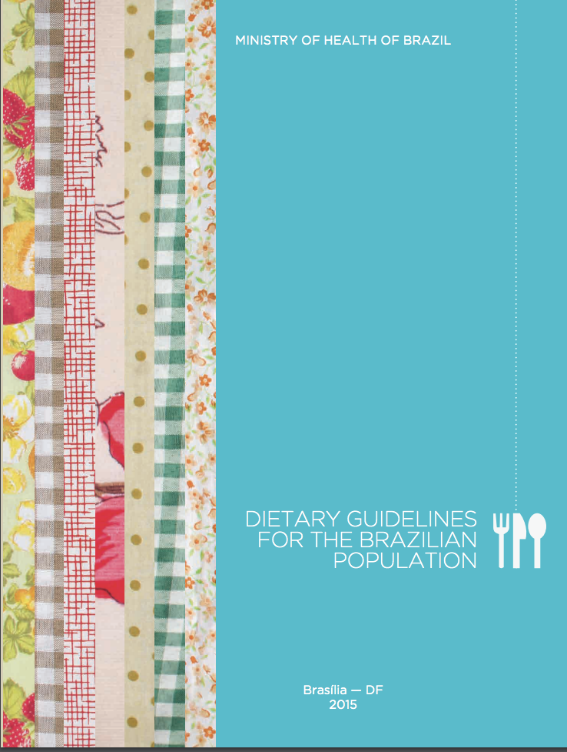
Dietary Guidelines for the Brazilian Population - 2014
Processed foods
Limit the use of processed foods, consuming them in small amounts as ingredients in culinary preparations or as part of meals based on natural or minimally processed foods.
The ingredients and techniques used in the manufacture of processed foods—such as vegetables in brine, fruits in syrup, cheeses, and breads - unfavorably alter the nutritional composition of the foods from which they are derived.
From Lunchbox to Lab: The Science Behind Processed Foods
16th October 2025

Slide 4
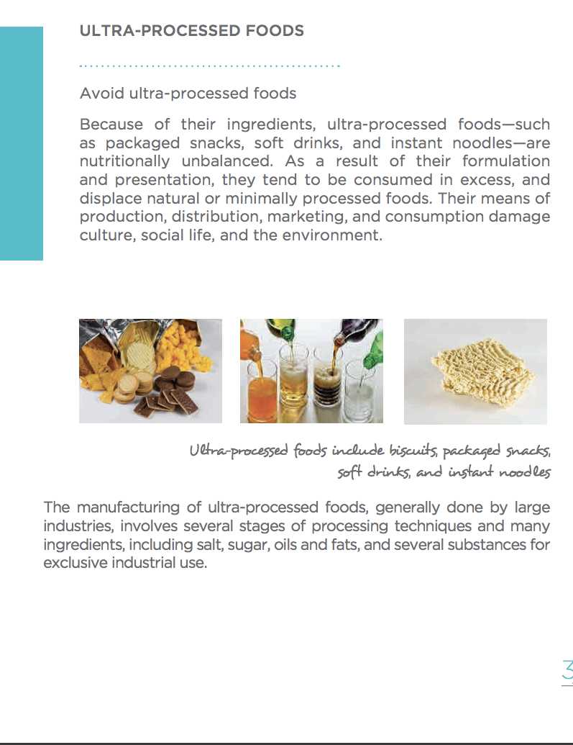
“Avoid Ultra-Processed Foods”
“As a result of their formulation and presentation, they tend to be consumed in excess, and displace natural or minimally processed foods.
Their means of production, distribution, marketing, and consumption damage culture, social life, and the environment.”
From Lunchbox to Lab: The Science Behind Processed Foods
16th October 2025

Slide 5
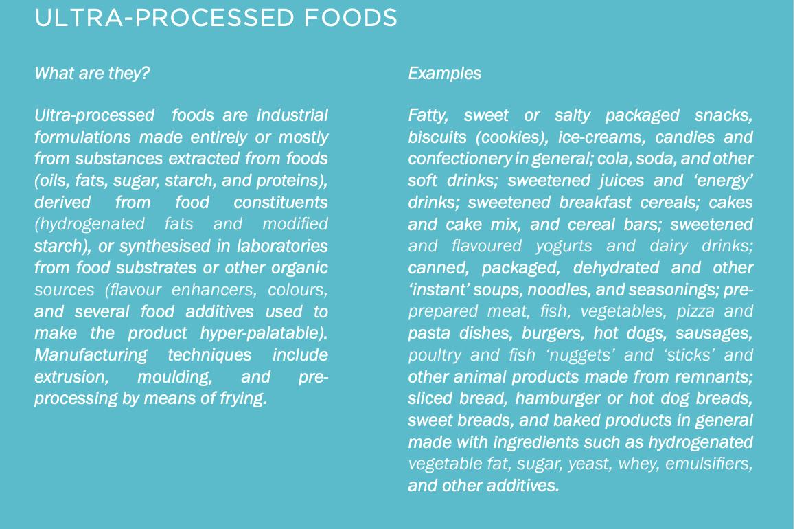
From Lunchbox to Lab: The Science Behind Processed Foods
16th October 2025

Slide 6

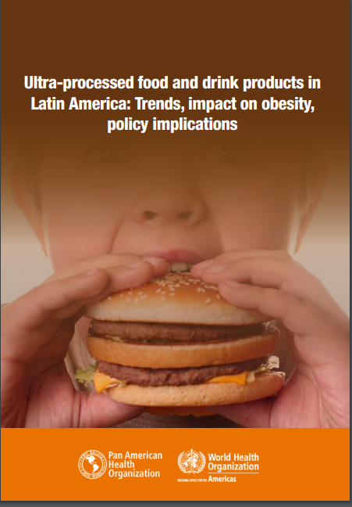
2015 - Introduces the NOVA classification
Adopts the word ultra-processed foods
Concludes that the association between annual sales per capita of “ultra-processed” foods and the increase of BMI…predicts obesity
From Lunchbox to Lab: The Science Behind Processed Foods
16th October 2025

Slide 7
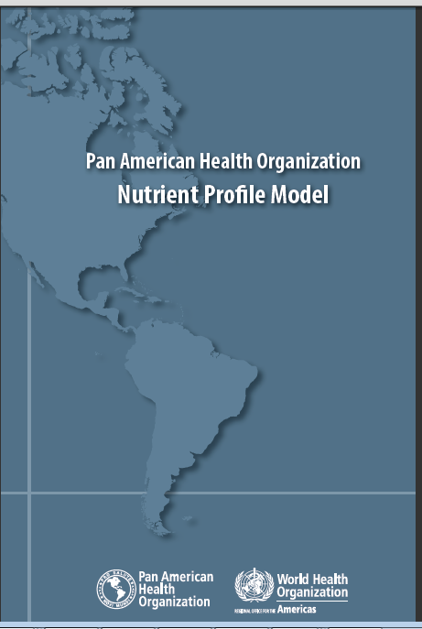
On February 18th 2016
PAHO publishes the Nutrient Profile Model
From Lunchbox to Lab: The Science Behind Processed Foods
16th October 2025

Slide 8
The PAHO NP model classifies a food product as “excessive” in one or more critical nutrients if its relative nutrient content is higher than the corresponding maximum level recommended in the WHO PNIGs
From Lunchbox to Lab: The Science Behind Processed Foods
16th October 2025

Slide 9
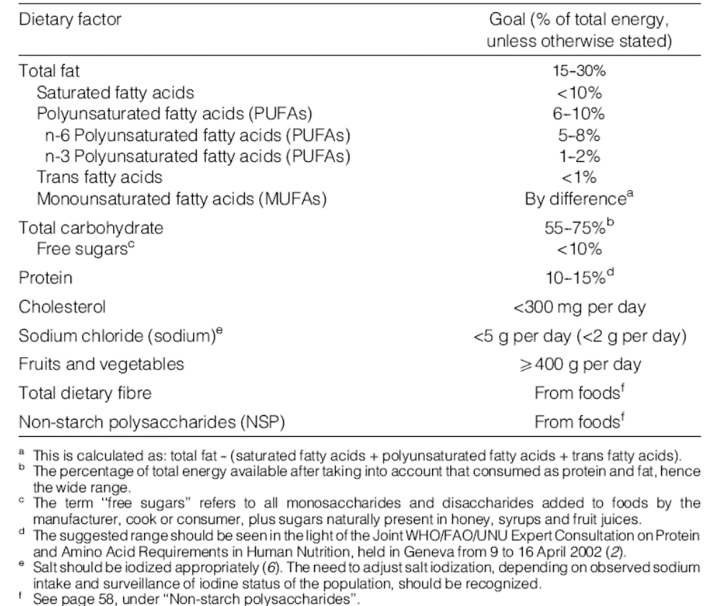
PAHO NPM Applies the Nutrient Consumption Goals (% of total energy)
(WHO 2003) to the Composition of Each Food

Slide 10
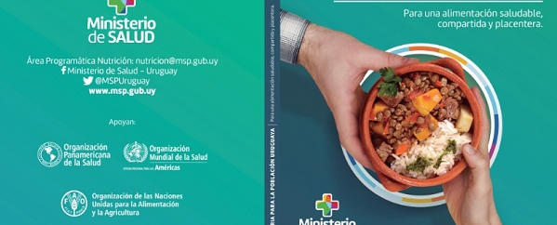
Dietary Guidelines for the Uruguayan Population
December 6, 2016

Slide 11
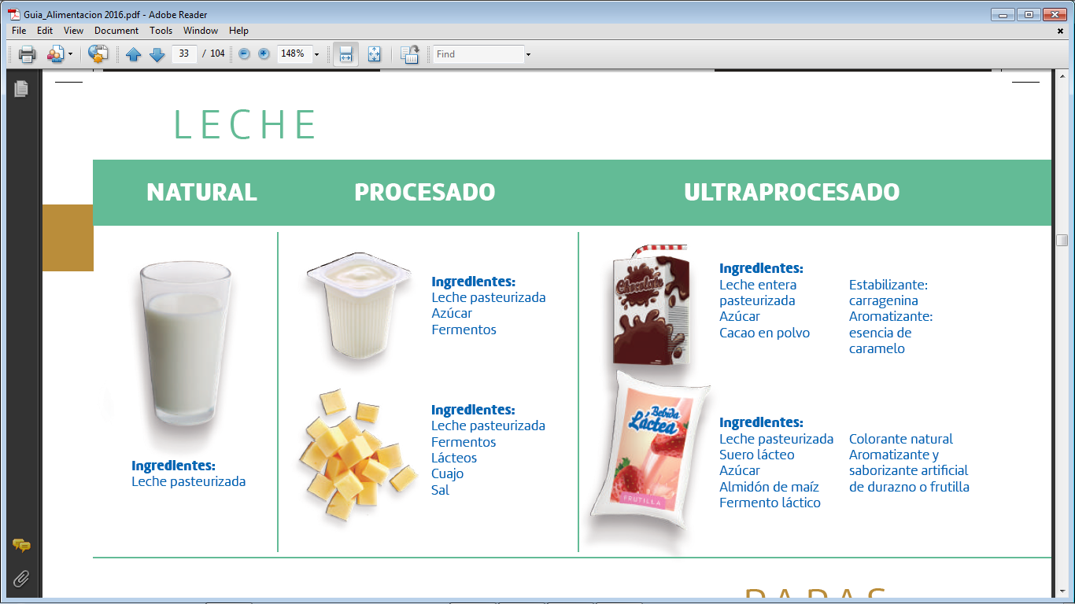
number of food additives defines an “ultra-processed” food
https://www.gub.uy/ministerio-desarrollo-social/comunicacion/publicaciones/guia-alimentaria-para-la-poblacion-uruguaya

Slide 12
NUPENS has defined industrial ingredients and food additives as the “markers” of UPFs.¹
“A practical way to identify an ultra-processed product is to check to see if its list of ingredients contains at least one item characteristic of the NOVA ultra-processed food group, which is to say, either food substances never or rarely used in kitchens (such as high-fructose corn syrup, hydrogenated or interesterified oils, and hydrolysed proteins), or classes of additives designed to make the final product palatable or more appealing (such as flavors, flavor enhancers, colors, emulsifiers, emulsifying salts, sweeteners, thickeners, and anti-foaming, bulking, carbonating, foaming, gelling and glazing agents).”²
1.- Canella, D.S., Pereira Montera, V.d., Oliveira, N. et al. Food additives and PAHO’s nutrient profile model as contributors’ elements to the identification of ultra-processed food products. Sci Rep 13, 13698 (2023). https://doi.org/10.1038/s41598-023-40650-3
2.- Monteiro CA, Cannon G, Levy RB, Moubarac JC, Louzada ML, Rauber F, Khandpur N, Cediel G, Neri D, Martinez-Steele E, Baraldi LG, Jaime PC. Ultra-processed foods: what they are and how to identify them. Public Health Nutr. 2019 Apr;22(5):936-941. doi: 10.1017/S1368980018003762.
From Lunchbox to Lab: The Science Behind Processed Foods
16th October 2025

Slide 13

Food means any substance, whether processed, semi-processed or raw, which is intended for human consumption, and includes drink, chewing gum and any substance which has been used in the manufacture, preparation or treatment of “food” but does not include cosmetics or tobacco or substances used only as drugs.
Food additive means any substance not normally consumed as a food by itself and not normally used as a typical ingredient of the food, whether or not it has nutritive value, the intentional addition of which to food for a technological (including organoleptic) purpose in the manufacture, processing, preparation, treatment, packing, packaging, transport or holding of such food results, or may be reasonably expected to result, (directly or indirectly) in it or its by-products becoming a component of or otherwise affecting the characteristics of such foods. The term does not include “contaminants” or substances added to food for maintaining or improving nutritional qualities.
From Lunchbox to Lab: The Science Behind Processed Foods
16th October 2025

Slide 14
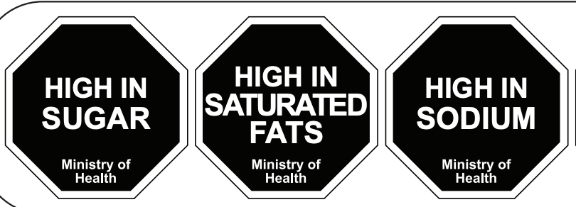
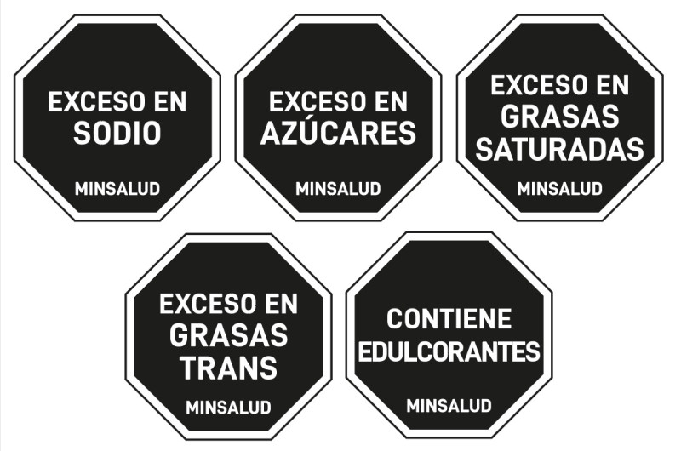

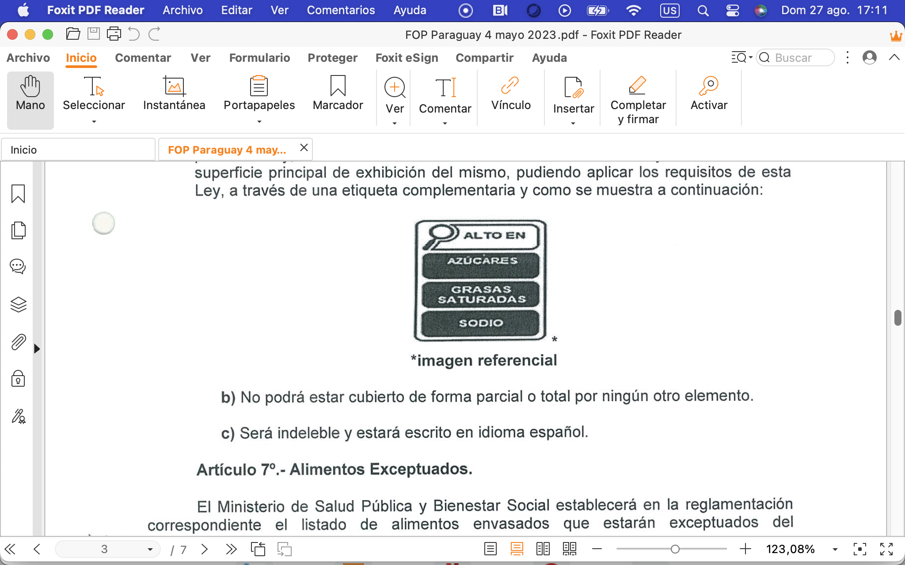
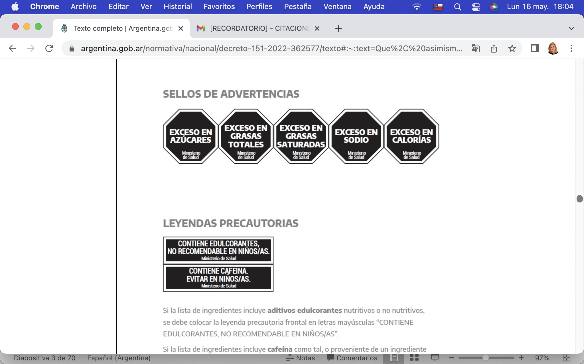

Slide 15
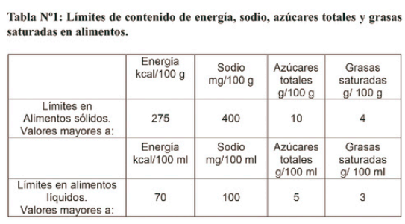


THRESHOLDS in g/100 g or 100 ml

Slide 16
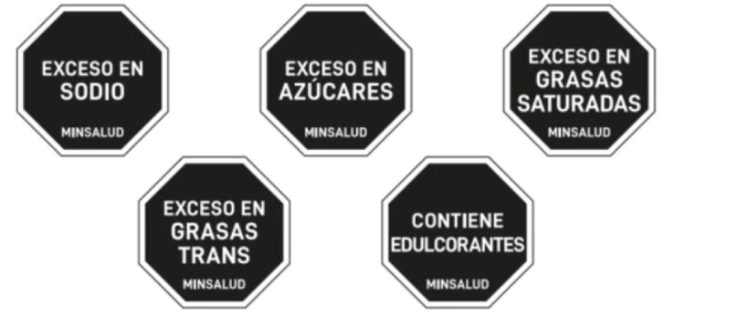
PAHO’S NUTRIENT PROFILE MODEL

Slide 17
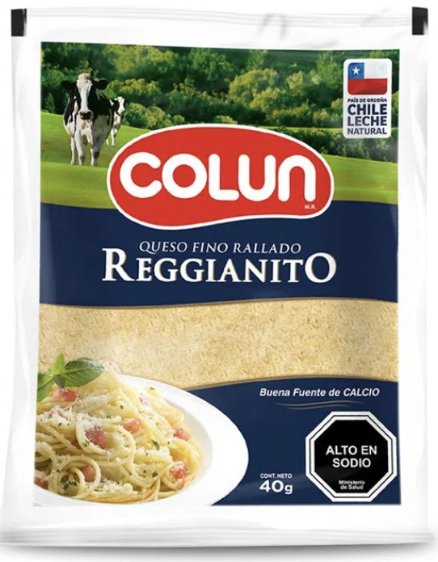
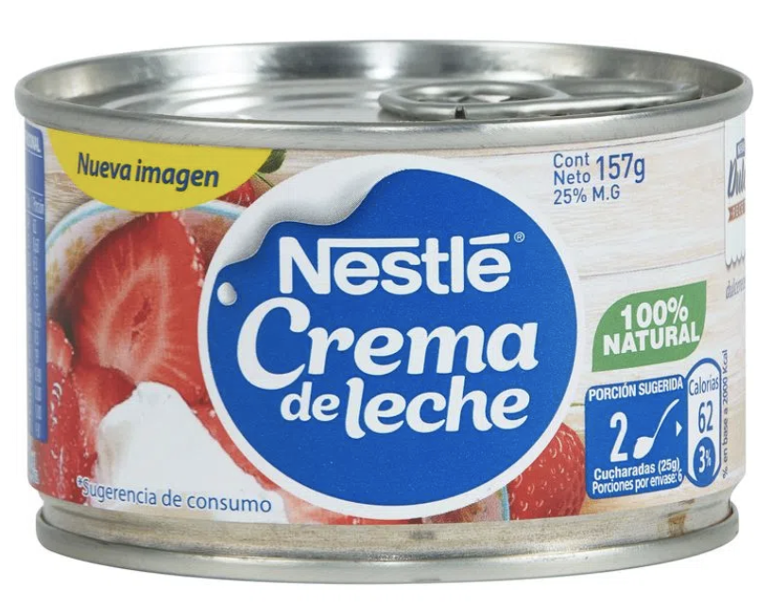
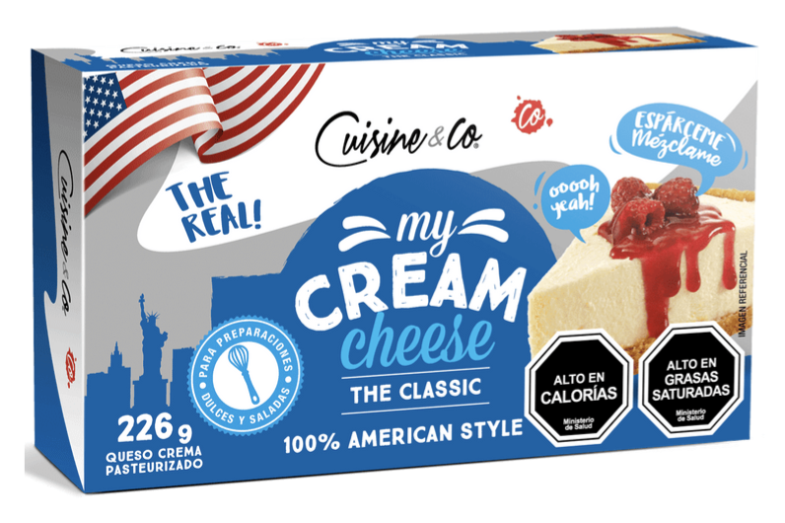
Excluding foods “not added with critical nutrients” provides wrong nutritional advice
The warning label is only required for foods to which sugars, honey, syrups, saturated fats, or sodium have been added and exceed the thresholds
From Lunchbox to Lab: The Science Behind Processed Foods
16th October 2025

Slide 18
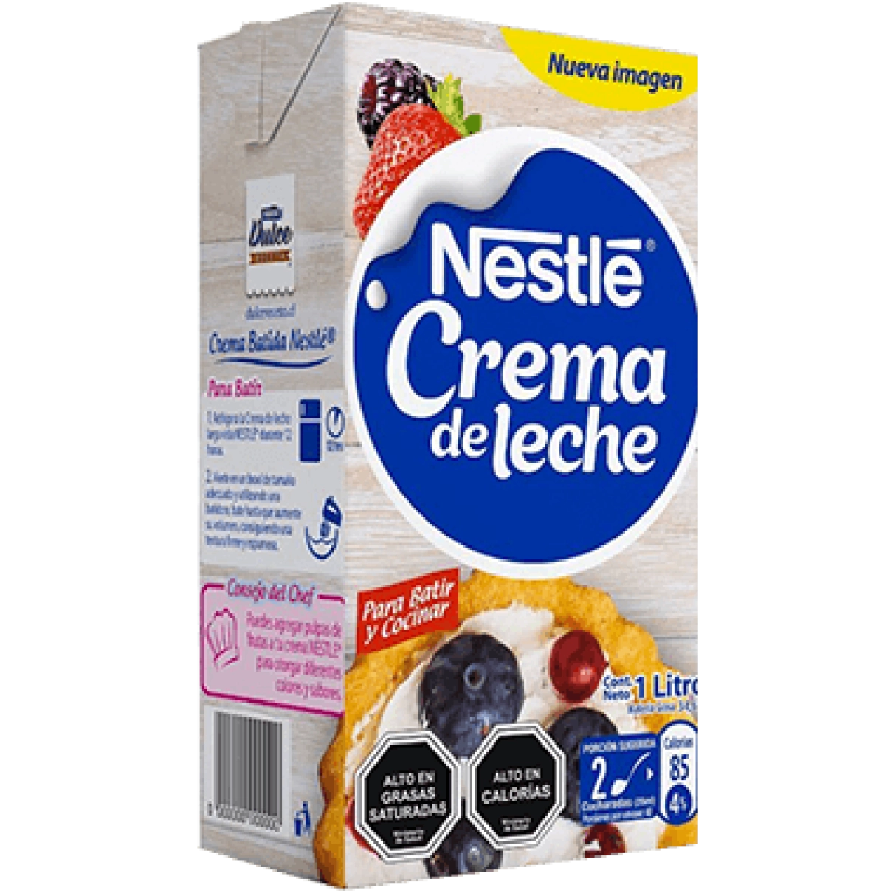
Ingredients:
Cream, skimmed milk powder, emulsifiers (mono- and diglycerides of fatty acids), stabilizers (carrageenans, xanthan gum).
Saturated fat. 21.5/100
Ingredients:
Cream.
Saturated fat 17/100
From Lunchbox to Lab: The Science Behind Processed Foods
16th October 2025

Slide 19


Warning labels determined with respect to the product’s total calorie content
Used when sugar contributes more than 10% of the product’s calories
Undefined thresholds
>8 g
Used when fat contributes more than 10% of the product’s calories
Used when trans fat contributes more than 10% of the product’s calories

Slide 20
WARNING LABEL “EXCESS SUGAR” IS INCONSISTENT WITH THE REAL SUGAR CONTENT
2.5 g sugar /100 ml
73 kcal /100 ml
  2.5 x 4 (kcal/g)= 10 kcal from sugar
  (10/73) x 100 = 14%
2.5 g sugar is considered LOW in the EU regulation, etc.
From Lunchbox to Lab: The Science Behind Processed Foods
16th October 2025

Slide 21
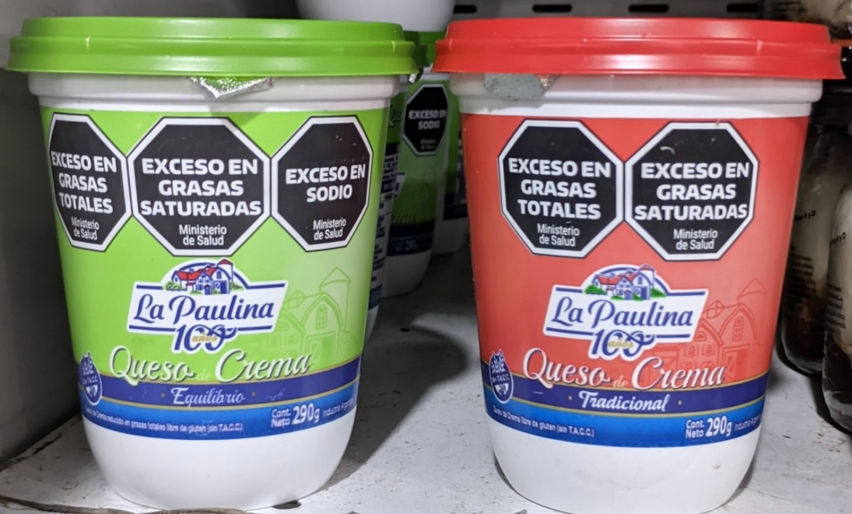

Reformulation is Hindered
Calories | 110 | 245
Total Fat | 5.3 | 22
Saturated Fat | 3.3 | 14
Sodium mg | 293 | 257
From Lunchbox to Lab: The Science Behind Processed Foods
16th October 2025

Slide 22
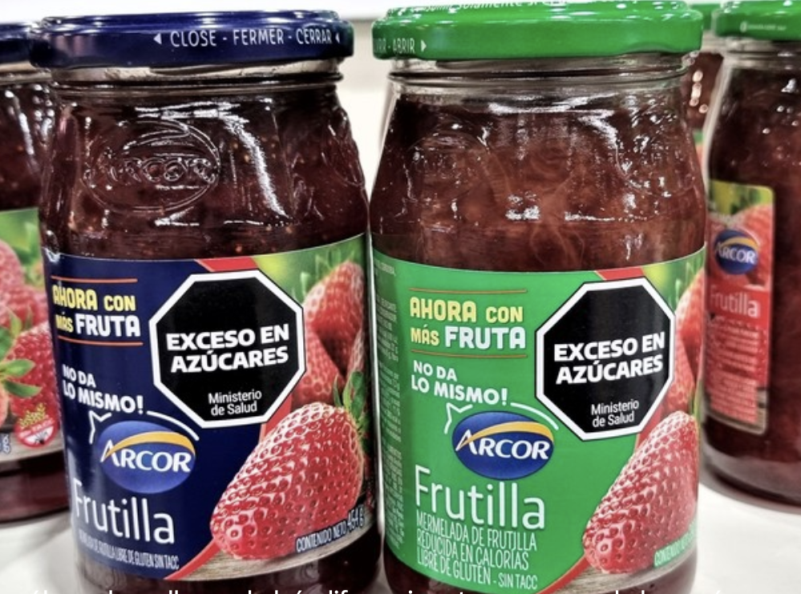
REDUCED SUGAR PRODUCTS CANNOT BE DISTINGUISHED FROM
FULL-SUGAR VERSIONS

Slide 23
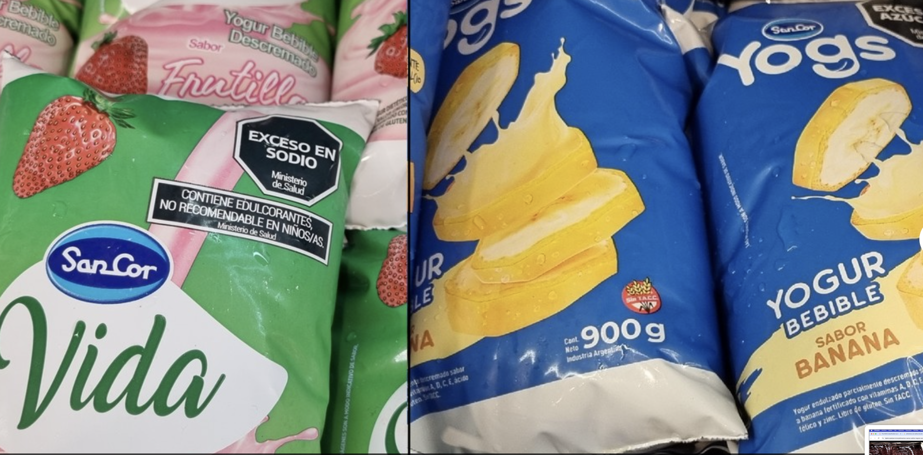
TO THE EYES OF A CONSUMER A LIGHT YOGURT LOOKS WORST THAN A REGULAR SUGAR-SWEETENED ONE

Slide 24
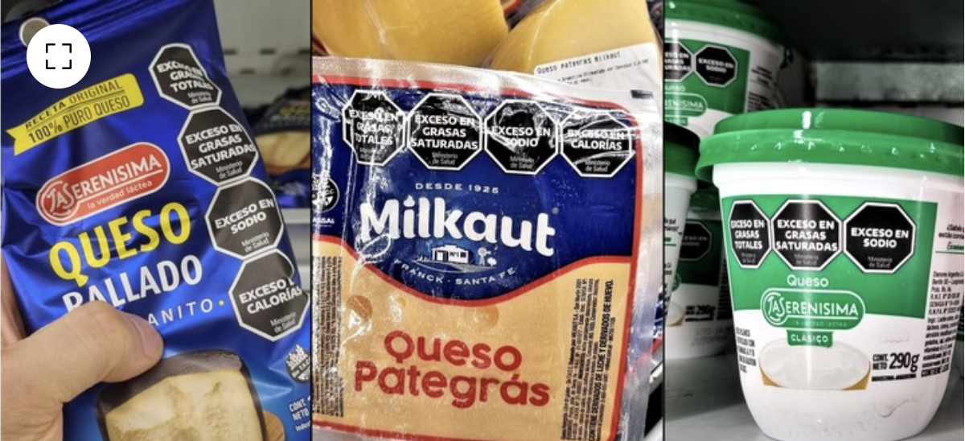

CONSUMERS CANNOT TELL THE DIFFERENCE
BETWEEN A LOW FAT CHEESE AND A PARMESAN CHEESE

Slide 25
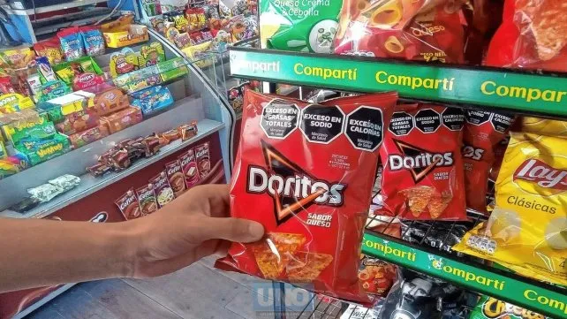

FOPNL should be applied to the food in a manner consistent with the corresponding nutrient declaration for that food.

Slide 26
In Conclusion
Scientific ambiguities of the classification system and the nutrient profile models applied, have led to front of pack regulations that provide incorrect information regarding the real nutrient content.
Consumers are confused and have increased consumption of non packaged foods.
Nutrition illiteracy has led to increasing obesity rates.
Food producers have difficulties in reformulating products to achieve better nutritional compositions.
From Lunchbox to Lab: The Science Behind Processed Foods
16th October 2025

Slide 27
Thank you!
From Lunchbox to Lab: The Science Behind Processed Foods
16th October 2025

