Slide 1

WORLD FOOD DAY
FEEDING HOPE:THE ROLE OF FOOD PROCESSING IN ENDING UNDERNUTRITION
Prof Jeyakumar Henry,
Senior Consultant , Global Centre for Asian women’s health,
National University of Singapore
From Lunchbox to Lab: The Science Behind Processed Foods
16th October 2025

Slide 2
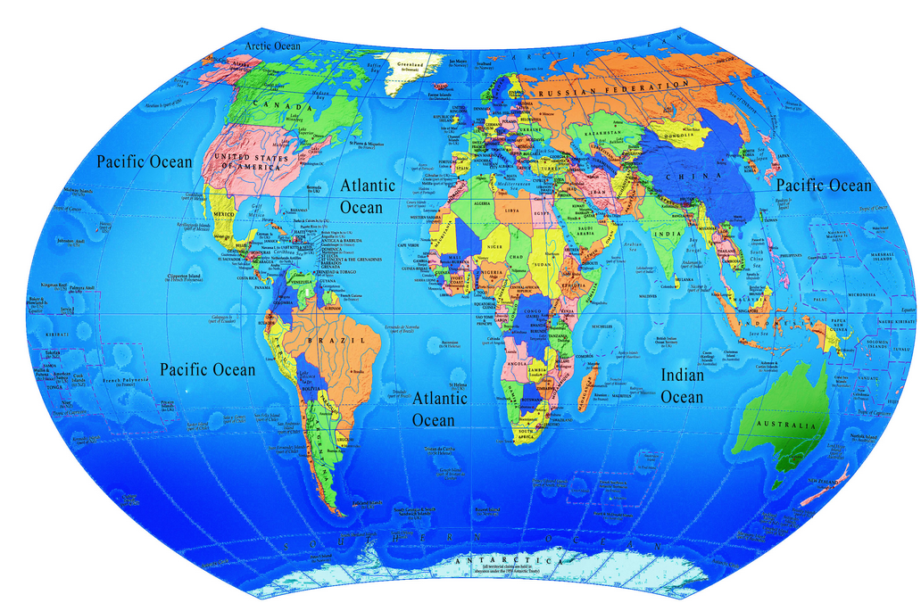
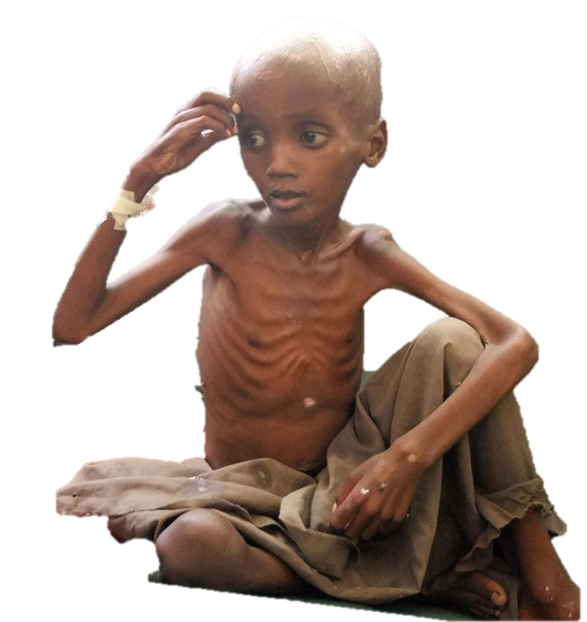



We live in a world of paradoxes
In 2024, more than 2.8 billion adults, were overweight or obese.
Where one half of the world is over-nourished and the other under-nourished
One ninth of humanity undernourished-
The number of hungry people in the world is growing, reaching 748 million in 2024
FAO, 2019

Slide 3
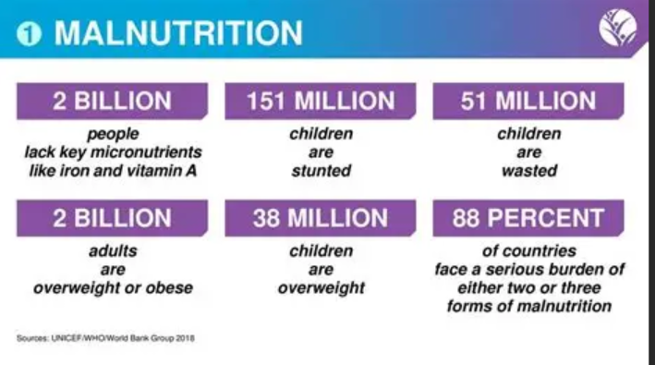

Slide 4
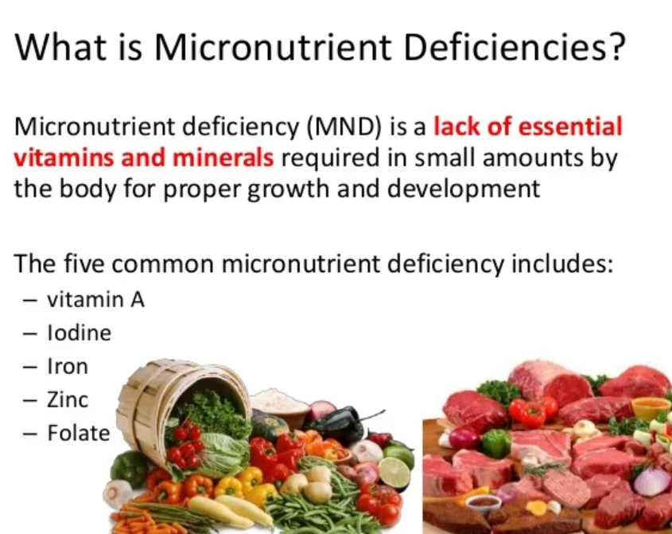

Slide 5
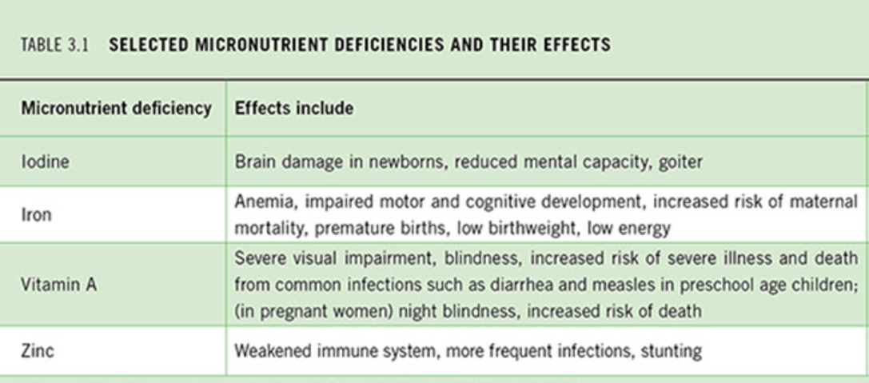

Slide 6
Adding essential micronutrients to staple food products like salt, sugar, and flour has proven one of the most cost-effective ways to enhance nutrition on a wide scale.
HIDDEN HUNGER AND FOOD FORTIFICTION
Hidden hunger refers to micronutrient deficiencies that occur despite adequate caloric intake, affecting over 2 billion people globally.

Slide 7
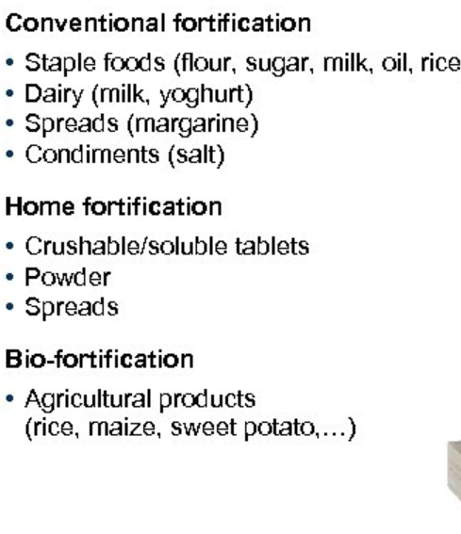
Different forms of Fortification
Food fortification is the process of adding essential vitamins and minerals to food products to enhance their nutritional value and combat nutrient deficiencies in populations.

Slide 8
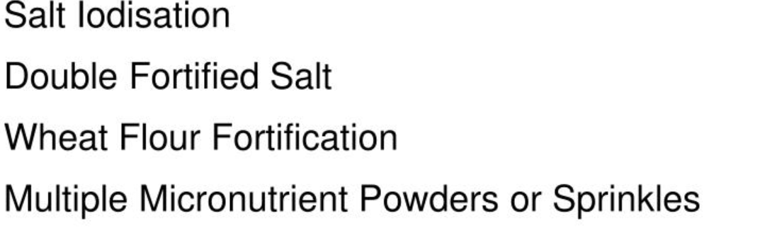
GLOBALLY SUCCESSFUL FORTIFIED FOODS

Slide 9
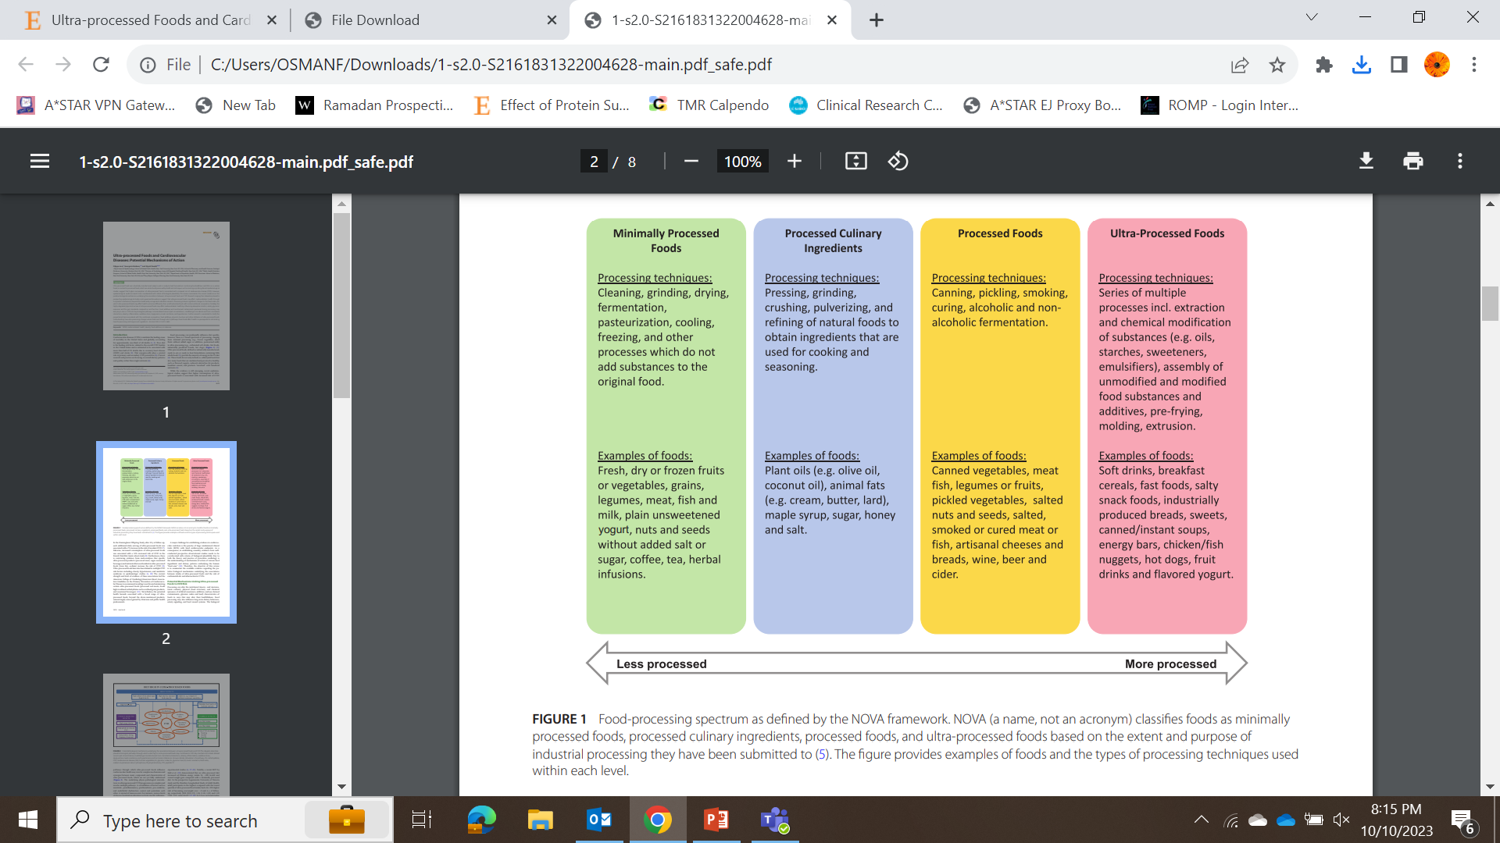
.

Slide 10


Slide 11
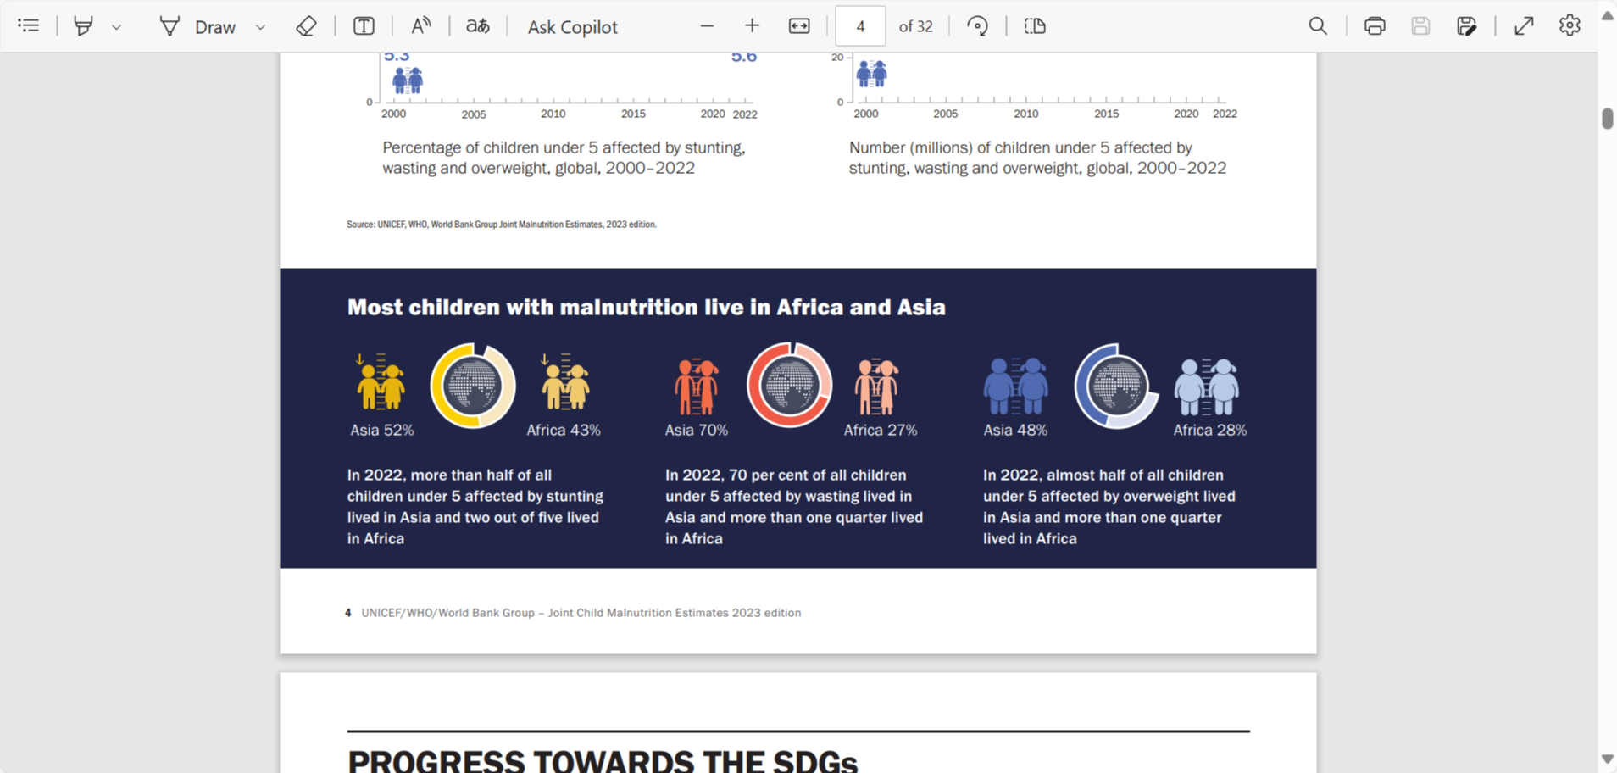

Slide 12
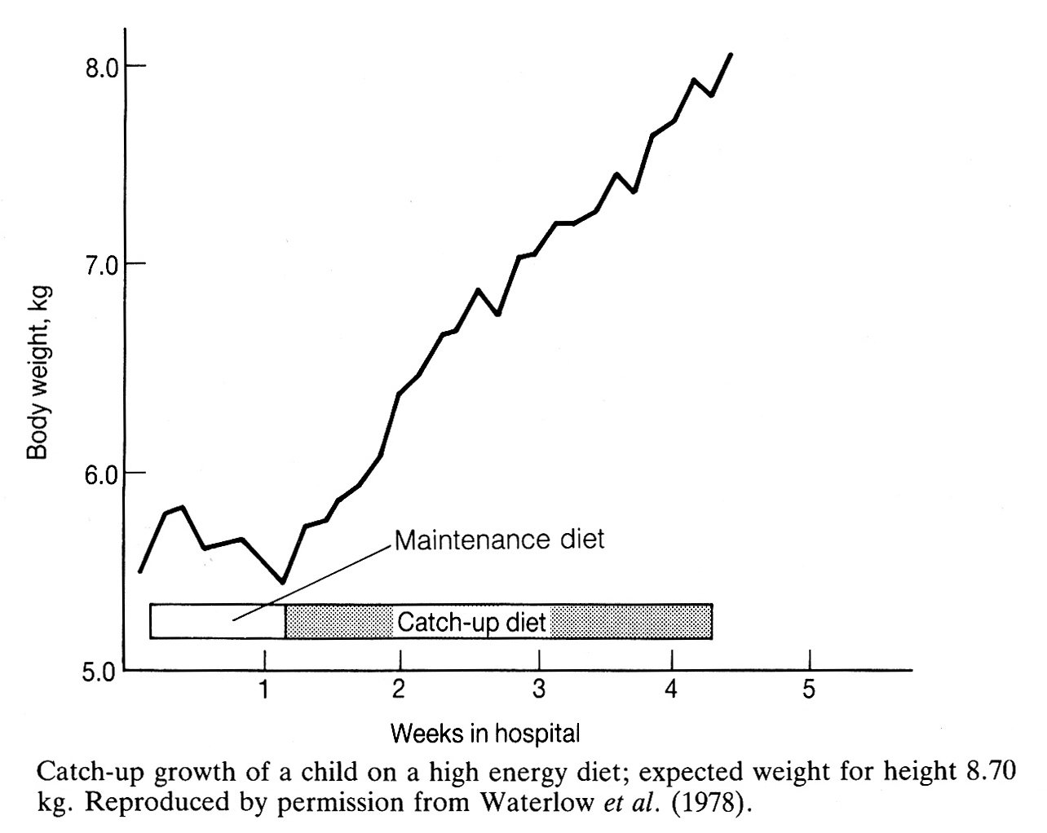
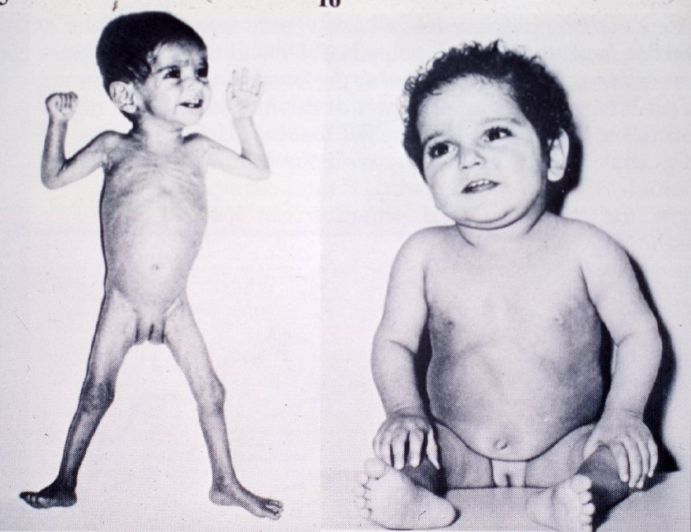

Slide 13
Composition of feeds for use during Phase 3 (rehabilitation)
A. Estimated requirement for catch-up growth at the rate of 20 g weight gain/kg/day
Energy 175 kcal
Protein 5.75 g/kg/day
B. Composition of feed
Dried skimmed milk (35% protein) 110 g/l = 38.5 g protein/l
Sugar 50 g/l
Oil 60 g/l
Total energy 1180 kcal/l

Slide 14
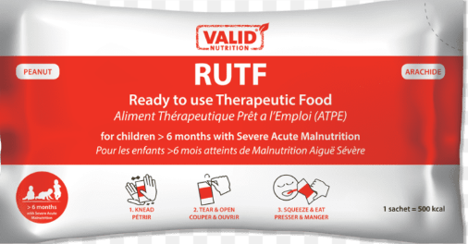
RUTF (ready-to-use therapeutic food)
It is made from powdered milk, peanuts, butter, vegetable oil, sugar, and a mix of vitamins and minerals.
One RUTF sachet combines 500 calories and micronutrients that have:
High nutritional value allowing malnourished children to gain weight quickly.
Two-year shelf life, making it convenient to pre-position in a warehouse.
Appealing taste and easy digestibility.
No need for preparation – children eat it directly from the packet.

Slide 15
.

Slide 16
CONCLUSIONS
1 If the NOVA classification is strictly applied in LMIC, many successful food fortification programs and development of RUTF to treat undernutrition may become a serious challenge
2 The unintentional consequence of applying the NOVA classification, will impede our progress in treating undernutrition and further delay many LMIC’s desire to meet their Millenium Development Goals (MDG).
3 the NOVA classification needs to consider the nutritional needs of billions of people living in LMIC. THE CURRENT CLASSIFICATION MAY HAVE UNINTENTIONAL CONSEQUENCES
4 IN ORDER TO BE GLOBALLY RELEVANT, Future refinement of the NOVA classification must include experts from LMIC, who understand the needs and challenges of their region

Slide 17
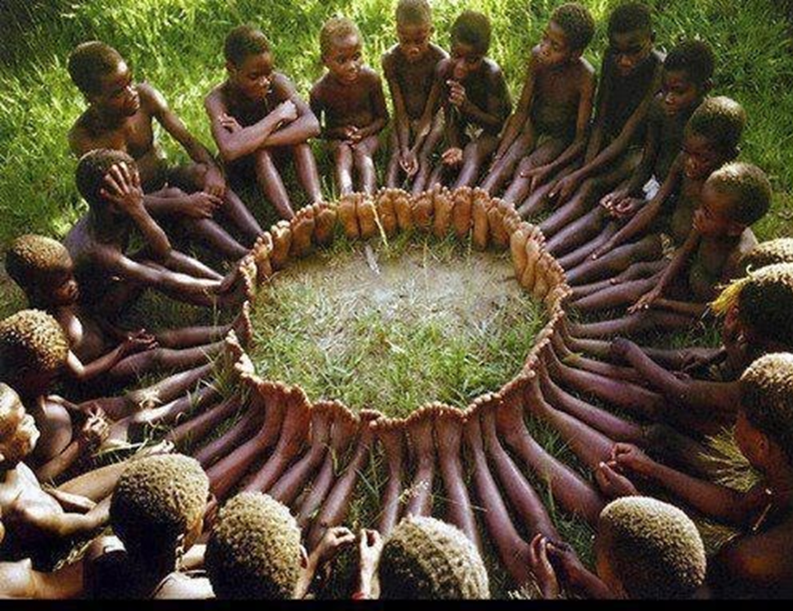
THANK YOU
Henrykumar39@gmail.com

